Slide 1
Ch 5.1 Inverse Functions

Slide 2
Inverse Functions
Suppose g is the inverse function for f.
Then g(b) = a if and only if f(a) = b
Examples – Suppose g is the inverse function for f, and we know the following
function values for f:
f(-3) = 5, f(2) = 1, f(5) = 0
Find g(5) and g(0)
Solution:
g(5) = - 3 because f(-3) = 5, and g(0) = 5 because f(5) = 0
To visualizing the two functions, as shown below
For the function f, the input variable is x and the output variable is y.
For the inverse function g, the roles of the variables are interchanged.
y is now the Input and x is the output
x= g(y)
Inverse Functions
y = f(x)
y | x
5 | - 3
1 | 2
0 | 5
x | y
- 3 | 5
2 | 1
5 | 0

Slide 3
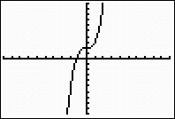
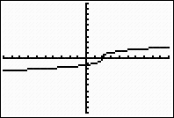
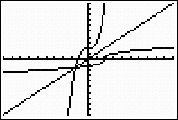
Inverse Functions
Suppose the inverse of f is a function, denoted by f ⁻¹. Then f ⁻¹ (y) = x if and only if f(x) = y
Graph the function f(x) = x³ + 2
And its inverse
f ⁻¹ (x) =
f(x)
f ⁻¹ (x)
y= x³ + 2
x³ = y – 2
x =
The inverse function is x = f ⁻¹(y) =
f⁻¹(10) = = 2

Slide 4
Inverse Functions
Input x
3 Output
f
g
6 Input
Output f(x)
The inverse of a function f is obtained by running the function machine in reverse
x | f(x)
1 | 2
2 | 4
3 | 6
4 | 8
x | f(x)
2 | 1
4 | 2
6 | 3
8 | 4
Inverse Function
Suppose g is the inverse function for f. Then g(b) = a if and only if f(a) = b

Slide 5
Graph of the Inverse Function
(a, b)
(b, a)
y= x
The graphs of y = f(x) and its inverse,
y = f ^{– 1} (x) or g(x), are reflections of each other about the line y = x

Slide 6
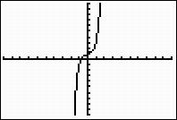
Horizontal Line Test
Horizontal Line Test- If no horizontal line intersects the graph of a
function more than once, then the inverse is also a function
A function that passes the horizontal line test is called one –to-one,
because each input has only one output and each output has only one
input. A one to one function passes the horizontal line test as well as
the vertical line test.
One-to-One Function – The inverse of a function f is also a function if
and only if f is one-to-one.

Slide 7
Horizontal Line Test
y = x²
f ⁻¹ (x) = y = + x
-
Inverse function
If no horizontal line intersects the graph of a function more than once,
then the inverse is also a function

Slide 8
The graphs y= 4x – 3, Interchange x and y and solve for y to get inverse of the function f ^{– 1} (x) = y = x + 3 4 4
y = x/4 + ¾ Inverse function
y = x
y = 4x - 3

Slide 9
Domain and range
Domain and range of the Inverse Function
If f ⁻¹ (x) is the inverse function for f(x), then
Domain (f ⁻¹) = Range (f)
Range (f ⁻¹) = Domain (f)

Slide 10
Functions and Inverse functions Suppose f ⁻¹ is the inverse function for f. Then f⁻¹ (f(x)) = x and f(f ⁻¹(y)) = y as long as x is in the domain of f, and y is in the domain of f ⁻¹
Example
Graph the function f(x) = 2 on the domain [-4, 12].
Graph its inverse function f ⁻¹ (x) = x² - 4
2
12
-4 12
- 4

Slide 11
Graph
x | -4 | -3 | 0 | 5 | 12
y =f(x) | 0 | 2 | 4 | 6 | 8
y | 0 | 2 | 4 | 6 | 8
y = f ⁻¹ (x) | -4 | -3 | 0 | 5 | 12
10
5
- 5
5 10

Slide 12
Ex 5.1, No 33 a) Find the domain and range of the function g(x) = b) Find a formula for g ⁻¹ (x) c) State the domain and range of g⁻¹(x) d) Graph g and g⁻¹ on the same grid
Domain : (- 4] : Range : [ 0, )
b. Let y = g(x) and solve for x
g(x) = y =
4
2
y² = 4 – x
x = 4 – y²
The inverse function is
g⁻¹(x) = 4 - x² Interchange x and y
Using x as the input Variable.
c) Domain : [ 0, )
Range : ( - , 4]
y = g(x) =
y = x
-
-4 -2 0
2 4
y = g⁻¹ (x)

Slide 13
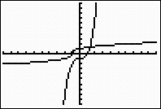
5.1 (Inverse function) pg417
No 30 f (x) =
f ¹(x) = x³ – 1 ( Inverse function )
Graph
x | -2 | -1 | 0 | 7
f(x) | -1 | 0 | 1 | 2
x | -1 | 0 | 1 | 2
f ¹ (x) | -2 | -1 | 0 | 7
Inverse Function

Slide 14
Ch 5.2 Logarithmic Functions

Slide 15
5.2 Inverse of logarithmic functions
Conversion formulas for logarithms
For any base b> 0 ,
y = log_{b}x , if and only if x = b^{y}
Logarithmic Function
The logarithmic function base b, g(x) = logb_{x} , is the inverse of the exponential
function of the same base, f(x) = b_{x}
For example, the function g(x)= log₂x, x is the inverse of f(x) = 2x. Each function undoes the
effect of the other. So if we start with x = 3, apply f, and then apply g to the result. We return to
he original number, 3
x = 3, f(3) = 2³ = 8 g(8) = log₂8 = 3
Apply the Apply the log function Original number
exponential function
We can write both calculations together as
log₂( 2 ³) = 3
Applying first the exponential function and then the log function returns the original input
value so that log_{b}b^{x}

Slide 16
Graphs of Exponential Functions
g(x)= log₂x
f(x)= 2^{x}
f(x)= 2^{x}
x | g(x)
1/8 | -3
1/4 | -2
1/2 | -1
1 | 0
2 | 1
4 | 2
8 | 3
x | f(x)
-3 | 1/8
-2 | 1/4
-1 | 1/2
0 | 1
1 | 2
2 | 4
3 | 8
g(x)= log₂x
f(x)= 2^{x}
g(x)= log₂x
- 5 5
- 5 5

Slide 17
Evaluating 10 ^{x} ( pg – 427) (Graphing Calculator )
If f(x) = log₁₀ x, find x so that f(x) = -3.2
Solution We must solve the equation log₁₀ x = -3.2. Rewriting the
equation in exponential form yields
x = 10 ^{-3.2}
= 0.00063
The expression 10 ^{-3.2} can be evaluated in two different ways with a
calculator. We can use the ^ key and press
10 ^ (-1) 3.2 ENTER
Which gives 6.30957344 E ^{– 4,} or approximately 0.00063.

Slide 18
Steps for solving Logarithmic Functions
Use the properties of Logarithms to combine all logs into one log
Isolate the log on one side of the equation
Convert the equation to exponential form
Solve for the variable
Check for extraneous solutions

Slide 19
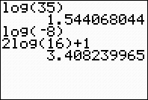
Evaluating Logarithmic Functions Use Log key on a calculator
Examples
Let f(x) = log ₁₀ x , Evaluate the following
A) f(35) = log ₁₀ 35 = 1.544
B) f(-8) = , -8 is not the domain of f , f(-8),
or log ₁₀ (-8) is undefined
C) 2f(16) + 1 = 2 log ₁₀ 16 + 1
= 2(1.204) + 1 = 3.408
In Graphing calculator

Slide 20
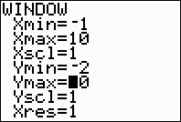
Graph each pair of functions on your calculator. Explain the result
No.64 f(x) = log(x/3) , g(x) = log x – log 3

Slide 21
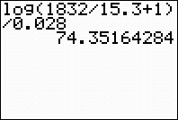
Example
Evaluate the expression log ₁₀ M_{f} + 1
T = M_{o}
K
For k = 0.028, M_{f} = 1832 and M_{o} = 15.3
T = log ₁₀ 1832 + 1
15.3 = log ₁₀ ( 120.739) = 2.082 = 74.35
0.028 0.028 0.028
In Gr. calculator

Slide 22
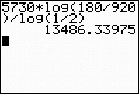
58
H log ₁₀ H= 5730, N = 180, N₀= 920
log ₁₀
5730 log ₁₀ 180 = 13486.33975
920
log ₁₀ ( )
N₀
T =
In Gr calulator
T =

Slide 23
Ch 5.3 The Natural Base

Slide 24
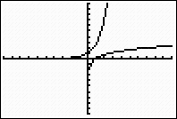
5.3 The Natural Base ( pg 438)
Natural logarithmic function (ln x)
In general, y= ln x if and only if e^{y} = x
Example e ^{2.3} = 10 or ln 10 = 2.3
In particular
ln e = 1 because e ¹ = e
ln 1 = 0 because e⁰ = 1
y = e ^{x}
y = x
y = ln x

Slide 25
Properties of Natural Logarithms (pg 439)
If x, y > 0, then
ln(xy) = ln x + ln y
ln = ln x – ln y
ln x^{m} = m ln x
The natural log and e^{x}
ln e^{x} = x for all x and e ^{lnx} = x, for x > 0

Slide 26
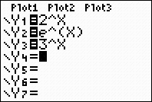
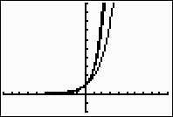
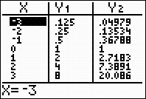
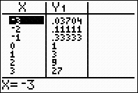
5.3 The Natural Base ( Pg 437 ) There is another base for logarithms and exponential functions that is often used in applications. This base is an irrational number called e, where e = 2.71828182845 The number e is essential for many advanced topics , and is often called natural base
y₁ = 2^{x} y ₂= e^{x}
y₃ = 3^{x}
3

Slide 27
Exponential Growth and Decay
The function
P(t) = P₀ e ^{kt}
Describes exponential growth if k > 0
And exponential decay if k < 0

Slide 28
Growth or Decay Factors
Exponential growth
P(t) = Po b ^{t} , where Po = P(0) is the initial value of the function and b is the
growth. If b> 1, which describes exponential growth when when P(t) is
increasing, and a = 1 + r, where r represents percent increase
Example P(t) = 100(2)^{t} Increasing 2 is a growth factor
Exponential Decay
P(t) = Po .e ^{kt} exponential decay If 0< b < 1,
Where we have substituted e ^{k} for the growth factor b in Equation
P(t) = Po b ^{t =} Po. (e ^{k} ) ^{t} = Po .e ^{kt}
We can find the value of k by solving the equation b = e ^{k} for k , to get k = ln b
P(t) is decreasing, and a = 1 – r, where r represents percent decrease
Example P(t) = 100( ) ^{t ,} Decreasing, is a decay factor
For bacteria population
we have
P(t) = 100.3 ^{t}
We can express this function in the form e ^{kt} if we set 3 = e ^{k} or k = ln3 = 1.0986
Thus the growth law for the colony of bacteria can be written
P(t) = 100. e ^{1.0986t}

Slide 29
Ex 5.3 ( Pg 446)
No 11. The number of bacteria in a culture grows according to the function N(t) = N₀ e ^{0.04t} , N₀ is the number of bacteria present at time t = 0 and t is the time in hours.
Growth law N(t) = 6000 e ^{0.04t}
N₀
c) Graph
N(t) = 6000 e ^{0.04t}
^{0.04(24)}
d) After 24 years, there were N(24) = 6000 e = 15,670
Let N(t) = 100,000;
100,000 = 6000 e ^{0.04t}
= e ^{0.04 t} ( divide by 6000 and reduce )
Change to logarithmic form :
0.04t = log_{e} = ln
t = ln = 70.3 hrs ( divide by 0.04)
There will be 100,000 bacteria present after about 70.3
t | 0 | 5 | 10 | 15 | 20 | 25 | 30
N(t) | 6000 | 7328 | 8951 | 10,933 | 13,353 | 16,310 | 19,921
15000
10000
5000
N(t)
10 20
t

Slide 30
Percent Increase Formula
A(t) = P(1 + r) ^{t}
A = amount
P = principal
r= rate
t = time

Slide 31
Ex 5.3, Pg 448
Solve, Round your answer to two decimal places
No 24 22.26 = 5.3 e ^{0.4x}
4.2 = e ^{1.2x} ( Divide by 5.3 )
Change to logarithmic form
1.2x = ln 4.2
x = = 1.196
Solve each equation for the specified variable
No. 33 y = k(1- e ^{- t}), for t
= 1- e ^{– t} (Divide by k)
- ¹ ⁺ ⁼ ⁻ e ^{– t} (Subtract 1)
e – t = 1 - ( multiply -1 )
- t ln e = ln( 1- ) (take ln both sides) ln e= 1
t = - ln ( 1 - ) ( Multiply -1) = - ln ( simplify ) = ln
ln

